Slide 1

.
FACE
RECOGNITION
TECHNOLOGY

Slide 2


PROJECT GUIDE:
DR. MANAS KUMAR MISHRA

Slide 3

TEAM NEST
PRAKHAR JAIN
19BCE10415
RISHITA SRIVASTAVA 19BCE10121
KANIKA
19BCE10165
SOUMYA SINGH
19BCE10159

Slide 4
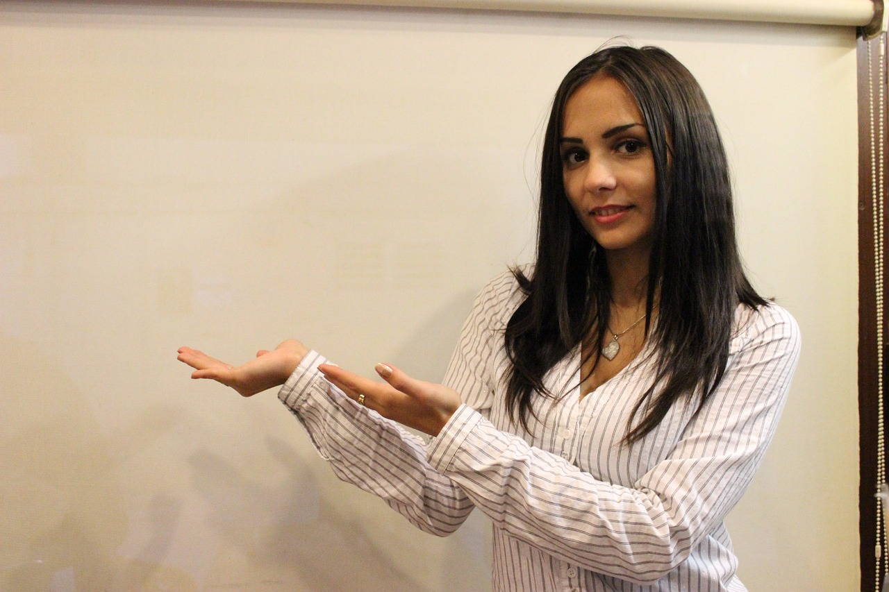
INTRODUCTION

Slide 5
Face recognition systems are being applied widely in real life such as tracking, managing employees, finding information about celebrities, and so forth. There are many approaches to design a face recognition system, but such these systems are frequently affected by light, non-frontal faces, resolution of cameras, etc. Thus, each method has specific challenges. Overall, a face recognition has two main stages which are face detection and face recognition, that leads our system to have three stages:
1) face detection
2) face recognition.

Slide 6
MOTIVATION
We know facial recognition are used in security systems, but it’s also used for marking attendance in schools, college , etc.
So here are some points which motivated people to use face recognition:
It’s a Non-Contact process.
Quite inexpensive when compared to other biometrics.
Increasing demand for fast and accurate authentication/identification.

Slide 7
EXISTING MODEL
The goal of face detection is to determine whether the image exists in the dataset and that of the Face recogniser is to recognize the face and provide information about the image . If multiple faces are present, each face is enclosed by a bounding box .
Human faces are difficult to model as there are many variables that can change for example facial expression, orientation, lighting conditions etc. As a result of this the existing face detectors and recognizers, recognize faces only when partial occlusions such as sunglasses, scarf, mask caps are not present.

Slide 8

WE DECIDED TO TAKE
THIS ONE STEP
AHEAD…...

Slide 9
Our project can detect Human faces also when partial occlusions such as sunglasses, scarf, mask caps are present.
Local Binary Pattern (LBP) is a simple yet very efficient texture operator which labels the pixels of an image by thresholding the neighborhood of each pixel and considers the result as a binary number.
It is a powerful feature for texture classification. It has further been determined that when LBP is combined with histograms of oriented gradients (HOG) descriptor, it improves the detection performance considerably on datasets.

Slide 10
MODULE WORKFLOW
EXPLANATION

Slide 11
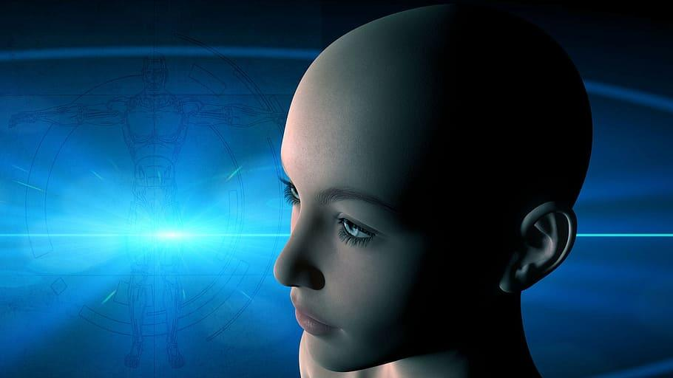
FACE DETECTION

Slide 12
Face detection -- also called facial detection -- is an artificial intelligence (AI) based computer technology used to find and identify human faces in digital images. Face detection technology can be applied to various fields -- including security, biometrics, law enforcement, entertainment and personal safety -- to provide surveillance and tracking of people in real time.
Face detection applications use algorithms and ML to find human faces within larger images, which often incorporate other non-face objects such as landscapes, buildings and other human body parts like feet or hands. Face detection algorithms typically start by searching for human eyes -- one of the easiest features to detect. The algorithm might then attempt to detect eyebrows, the mouth, nose, nostrils and the iris. Once the algorithm concludes that it has found a facial region, it applies additional tests to confirm that it has, in fact, detected a face.

Slide 13
The face detector proposed used Haar-Like features cascaded classifiers, which achieve good performance with real-time efficiency. However, a few works show that Haar-Like feature may degrade considerably in real world applications with larger visual variations of human faces even with more advanced features and more training images.

Slide 14

FACE RECOGNITION

Slide 15
Local Binary Pattern Histogram (LBP) is a simple yet very efficient texture operator which labels the pixels of an image by thresholding the neighborhood of each pixel and considers the result as a binary number.
It is a powerful feature for texture classification. It has further been determined that when LBP is combined with histograms of oriented gradients (HOG) descriptor, it improves the detection performance considerably on some datasets.
Using the LBPH combined with histograms we can represent the face images with a simple data vector. As LBPH is a visual descriptor it can also be used for face recognition tasks.

Slide 16
Stepwise Algorithm Explanation
Step 1:
Import cv2 and numpy and also use the CascadeClassifier function of OpenCV to point to the location where we have stored the XML file,haarcascade_frontalface_default.xml in our case.
Step 2:
Load the image and convert it into gray-scale. When OpenCV reads the RGB image, it usually stores the image in BGR (Blue, Green, Red) channel. For the purposes of image recognition, we need to convert this BGR channel to gray channel. The reason for this is gray channel is easy to process and is computationally less intensive as it contains only 1-channel of black-white.

Slide 17
Step 3:
Now try to locate the exact features in our face. We are using the face_classifier which is an object loaded with haarcascade_frontalface_default.xml, we are using an inbuilt function with it called the detectMultiScale. This function will help us to find the features/locations of the new image.
Step 4:
The function detectMultiScale returns 4 values — x-coordinate, y-coordinate, width(w) and height(h) of the detected feature of the face. Based on these 4 values we will draw a rectangle around the face.

Slide 18
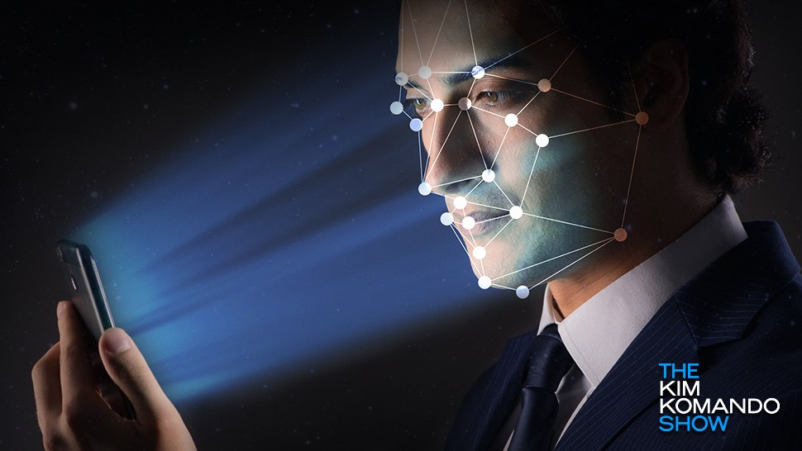
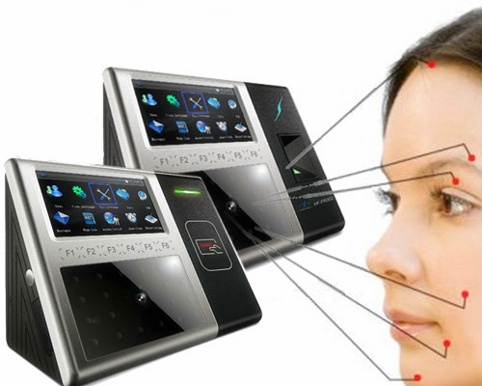
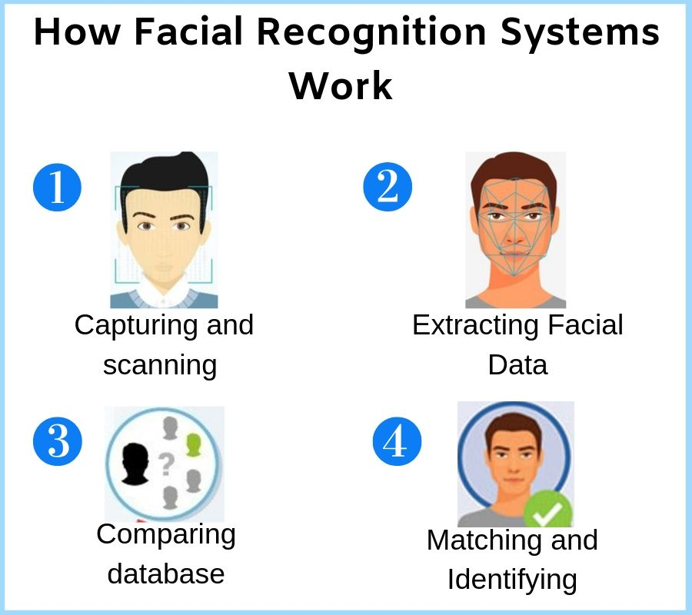
REAL TIME USAGE
A. UNLOCKING OF PHONES
B. FACE ATTENDANCE SYSTEM
C. Aid in Forensic and Crime Investigation

Slide 19
Novelty of the project
In this difficult time of COVID-19 pandemic, it is very important to maintain social distancing and stop the spread of this virus. In fact, Face Recognition system can help in minimizing the spread of coronavirus by avoiding the contact of this virus via touch id attendance system used in institutions. We can use Face recognition system instead of touch id attendance system because of the following reasons-
Touch-Free: unlike the fingerprint hardware that employee should use his finger, the face terminals doesn’t require body punch,
Fast and accurate identification: employee should only look at the device for less than a second he will be identified.
Hygienic: Facial recognition technology does not require any physical engagement.
Response time: less than a second

Slide 20
HARDWARE AND SOFTWARE REQUIREMENTS
HARDWARE:
Web camera
SOFTWARE:
Python libraries:
OpenCv (cv2)
Sys
Numpy
Os
Time
Glob
Flask, MySQL

Slide 21
LITERATURE REVIEW
The world believes that Woodrow Wilson Bledsoe was the father of facial recognition. In the 1960s, Bledsoe created a system that could organize faces’ photos by hand using the RAND tablet. The tablet is a device people could use to enter vertical and horizontal coordinates on a grid with the help of a stylus that released electromagnetic pulses. People used that system to manually record the coordinate areas of facial features like eyes, nose, mouth, and hairline.
The manually recorded metrics could be later saved within a database. And when the new photograph of an individual was entered into the system, it was able to get the most closely resembled image via database. During this period, face recognition was untouched by technology and computer processing power. Still, it was the first and foremost step taken by Bledsoe to prove that face recognition was a practical biometric.

Slide 22
21 Facial Markers for enhanced accuracy in the 1970s
It was in the 1970s when Harmon, Goldstein, and Lesk made the manual facial recognition system more accurate. The three used 21 facial markers including lip thickness and hair color, to detect faces automatically. However, the Bledsoe’s system was still computed with actual biometrics, done manually.
Eigenfaces
Sirovich and Kirby started using linear algebra to the issue of facial recognition in 1988. The approach they used was called the Eigenface approach. The rendering began as a search for low-dimensional facial images representation. The team was able to prove that feature analysis on collected pictures in the database could form a set of basic features.

Slide 23
They were also able to explain how less than a hundred values could be used to code a face image precisely. In 1991, Pentland and Turk worked further on the Eigenfaces approach by finding ways to detect faces within images. Pentland and Turk’s work was the first automatic face recognition attempt. They used technological and environmental factors for their approach. Then in the 1993-2000s period, DARPA and NIST released the FERET program to encourage the commercial facial recognition market. In 2002, law enforcement officials applied facial recognition in critical technology testing.
Social Media 2010 to present
When 2010 started, Facebook started using a facial recognition feature that helped detect people with featured faces in the photos updated by Facebook users. While the update created hype in the media industry — Facebook stayed very low key since there was no apparent negative impact on website popularity and usage.

Slide 24


Slide 25
MODULE DESCRIPTION
In this system we are using Haar feature- based cascade classifiers .It is an effective object detection method proposed by Paul Viola and Michael Jones.It is a machine learning approach where a cascade function is trained from a lot of positive and negative images.It is then used to detect objects in other images.
We are first creating a Web API using flask to collect the images of people for database . It will take mentioned number of images consecutively. And then store in a folder under the name of that particular candidate. This procedure will be done only once.
Next step would be “recognizing” the person. The algorithm designed is context-aware.
To find similar images Convolutional Neural network is being used.We can access all patterns of images with this facial recognition module which helps in maintaining security of devises. OpenCv always proves beneficial in face recognition and eye detection module.

Slide 26

Approach And Algorithms Used

Slide 27
LBPH Algorithm
Local Binary Pattern (LBP) is a simple yet very efficient texture operator which labels the pixels of an image by thresholding the neighborhood of each pixel and considers the result as a binary number.
It is a powerful feature for texture classification. It has further been determined that when LBP is combined with histograms of oriented gradients (HOG) descriptor, it improves the detection performance considerably on some datasets.
Using the LBP combined with histograms we can represent the face images with a simple data vector. As LBP is a visual descriptor it can also be used for face recognition tasks.
The first computational step of the LBPH is to create an intermediate image that describes the original image in a better way, by highlighting the facial characteristics. To do so, the algorithm uses a concept of a sliding window, based on the parameters radius and neighbors.

Slide 28
HAAR CASCADE CLASSIFIERS
Haar Cascade classifier is an effective object detection approach. This is basically a machine learning based approach where a cascade function is trained from a lot of images both positive and negative. Based on the training it is then used to detect the objects in the other images.
So how this works is they are huge individual .xml files with a lot of feature sets and each xml corresponds to a very specific type of use case. There is a particular xml file containing the feature set to detect the full body, lower-body, eye, frontal-face and so on.
To detect the face of individuals we are using the haarcascade_frontalface_default.xml.

Slide 29


IMPLEMENTATION AND CODING

Slide 30

CODE FOR CREATING
DATASET

Slide 31


Slide 32
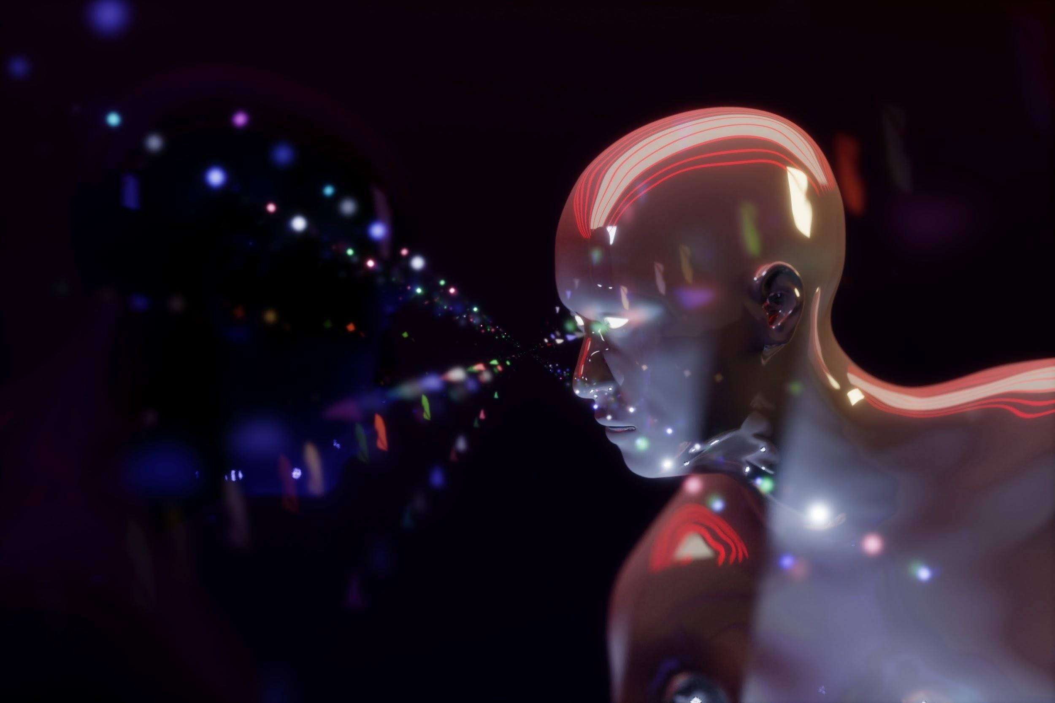
CODE
FOR
TRAINING
THE
MODEL

Slide 33


Slide 34

CODE
FOR
FACE RECOGNITION

Slide 35


Slide 36

DEMONSTRATIONS THOUGH
VIDEOS

Slide 37

VIDEO 1

Slide 38
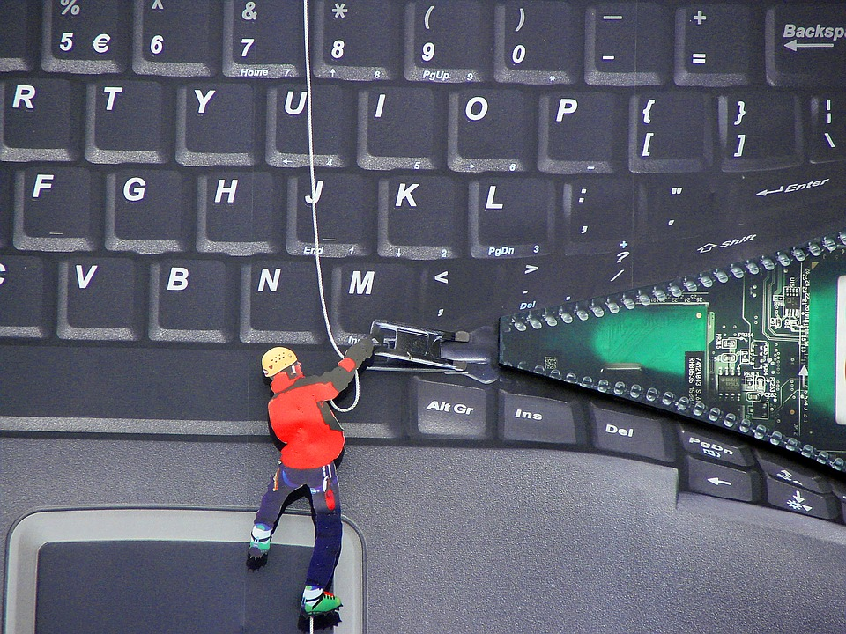
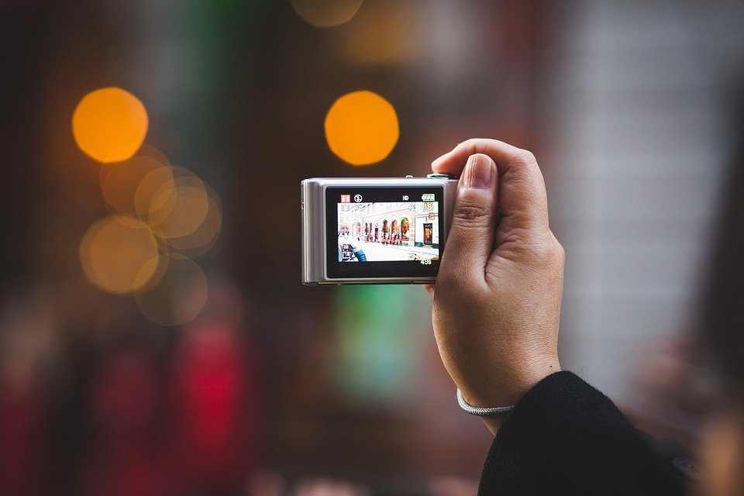
SNAPSHOTS
Of
PROJECT

Slide 39
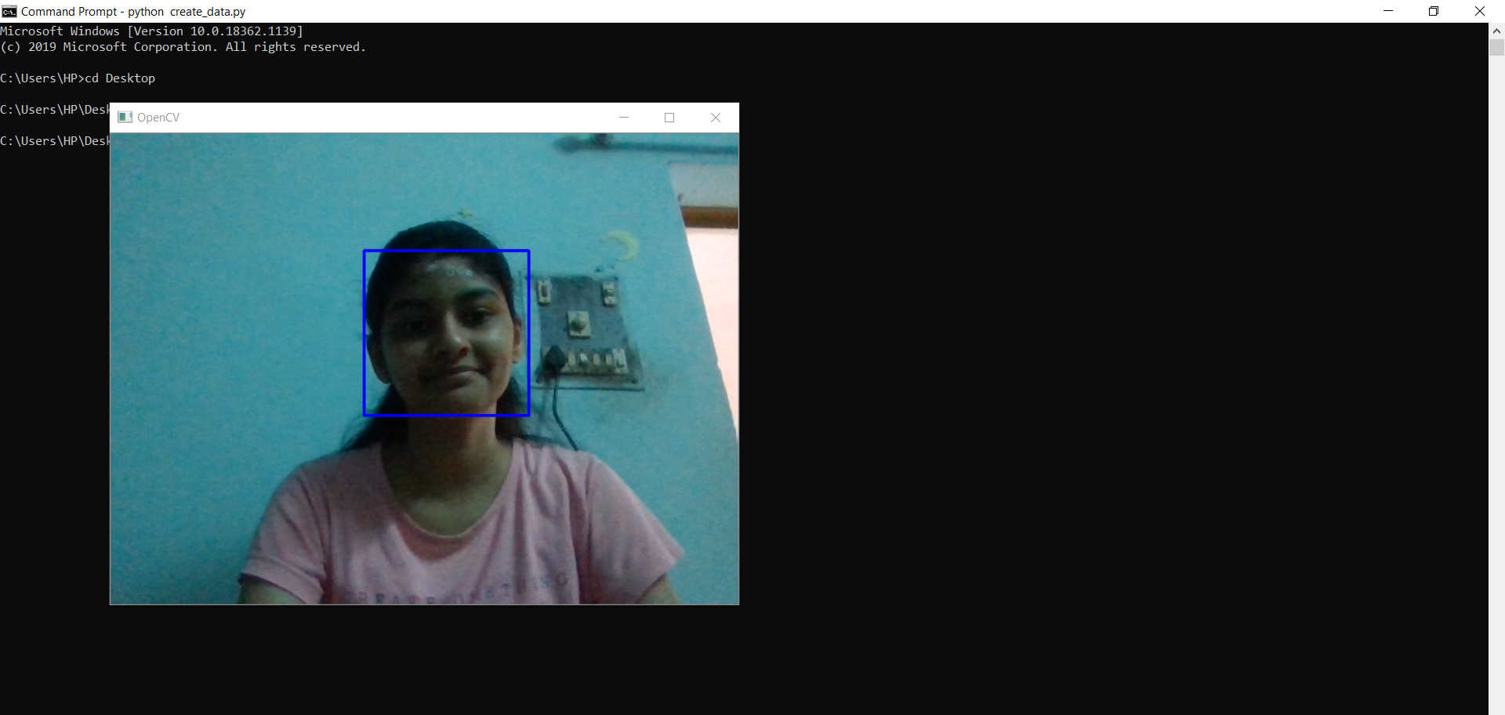

Slide 40
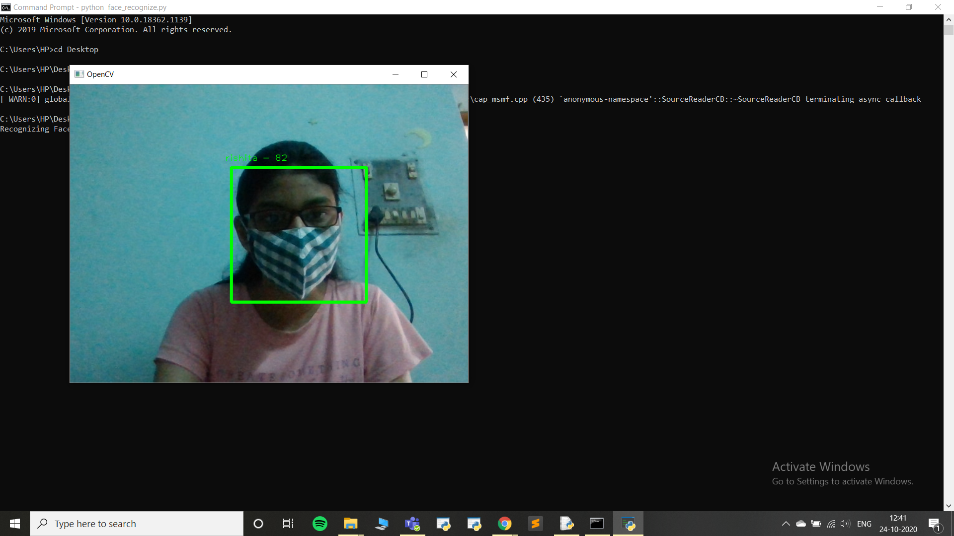

Slide 41
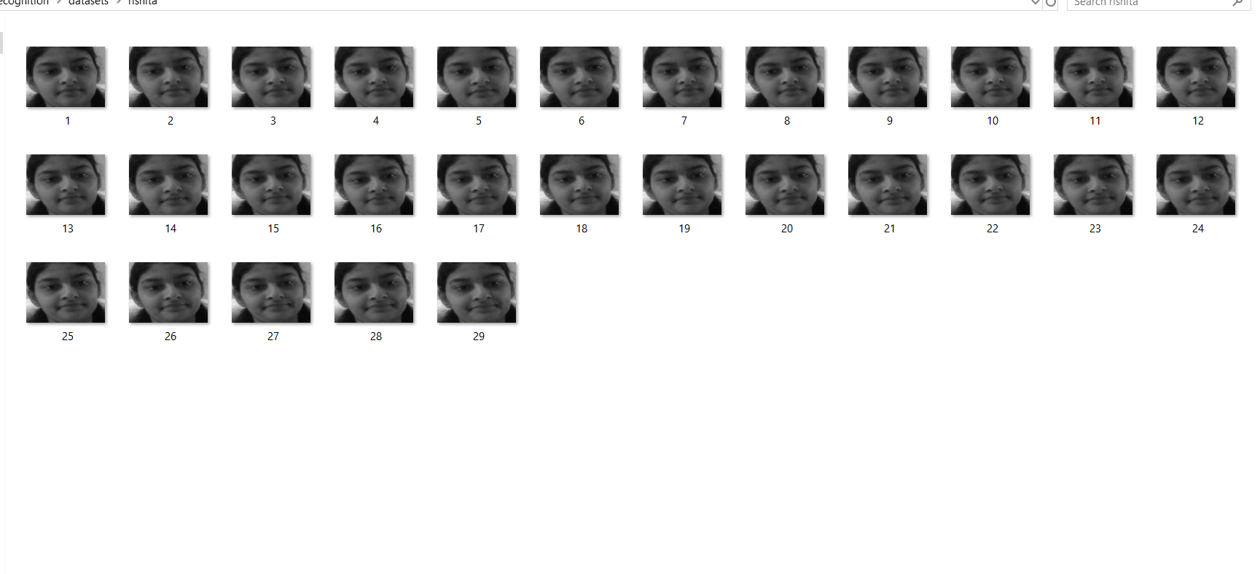
TESTING

Slide 42

CODE FOR WEB BASED API USING FLASK

Slide 43
For the ease of collecting pictures of different people to create our dataset , we can create a web API for create_data python file using flask . So that the API can run in backend and the other person can directly add pictures with the link.
We’ll create a RESTful API using Flask. A RESTful API is an architectural style for an application program interface (API) that uses HTTP requests to access and use data. That data can be used to GET, PUT, POST and DELETE data types, which refers to the reading, updating, creating and deleting of operations concerning resources.

Slide 44


Slide 45
VIDEO

Slide 46


Slide 47
CONSTRAINTS OF THE SYSTEM
1) Model Complexity
LBPH architecture is used which is very complex and unsuitable for real-time performance on embedded devices.
2)Expressions
Face is one of the most crucial biometrics as its unique features play a crucial role in providing human identity and emotions. Varying situations cause different moods which result in showing various emotions and eventually change in facial expressions.
3)Blur pictures
Facial Recognition Systems are highly sensitive . So if the images are not clear then the system will not be able to perform effectively. Though we are clicking 30 images.

Slide 48
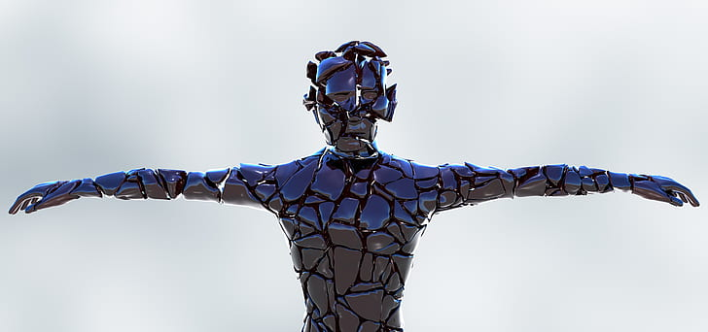
FUTURE SCOPE

Slide 49
Emotion Reading :
Facial recognition technology is continuously improving with every passing day. With machine learning algorithms, now the systems are able to read facial expressions and detect emotions. The technology is proving to be very helpful for the legal authorities.
A Parameter for Secure Growth
Security and customer experience are the two main factors that drive the secure growth of the business. Facial recognition is a competitive technology that is facilitating industries to effectively meet both the factors without compromising the other.

Slide 50


Slide 51
Facial recognition technology has many applications in day care, residential security, voter verification, banking using atm and in many other fields.
Face recognition technologies have been associated generally with
very costly top secure applications.
In our project we our aiming at achieving it at the ground level. According to the present scenario, we are seeking for touch free ways and this could be a ‘blessing in disguise’ .
We can implement this technology in our college campus for taking attendance, since our system is able to detect faces even after wearing masks. So this will be useful in and after Covid-19 situation.

Slide 52


